Slide 1

@maaretp
@LlewellynFalco

Slide 2
Developing a new feature

Slide 3

Developer

Slide 4
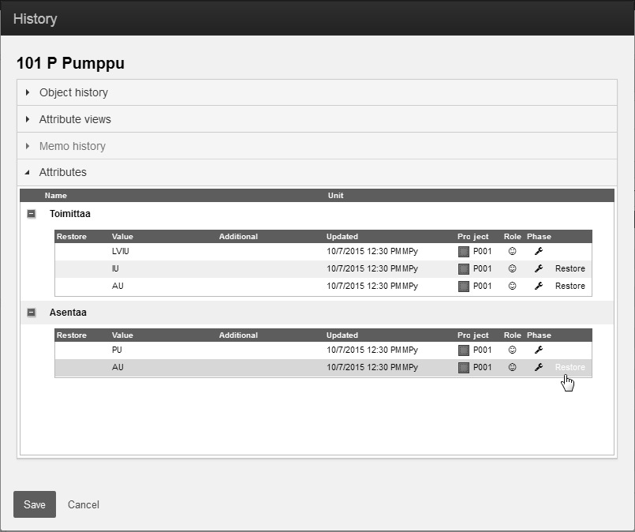

Slide 5
Tester

Slide 6
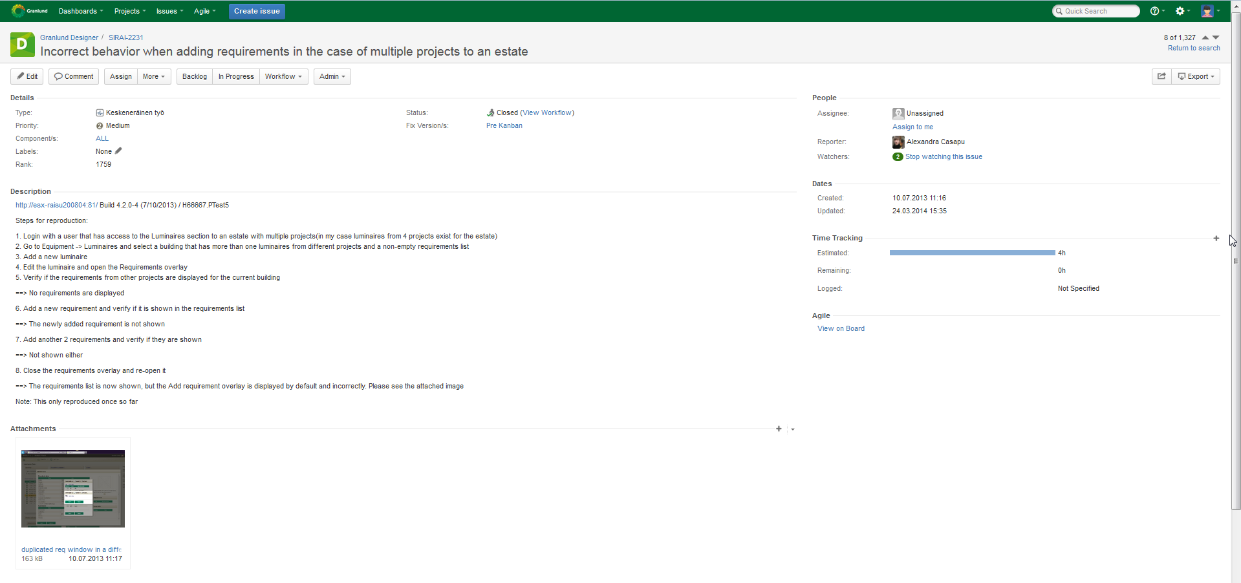

Slide 7
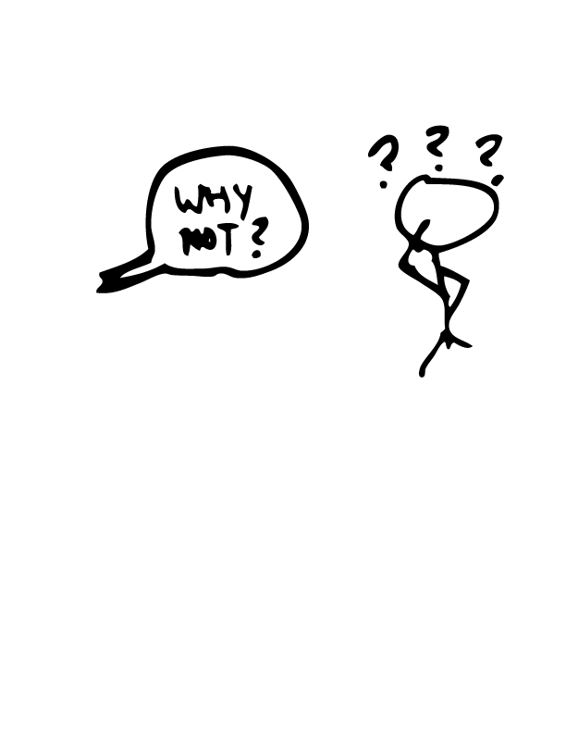
?!?%#

Slide 8
Except…

Slide 9
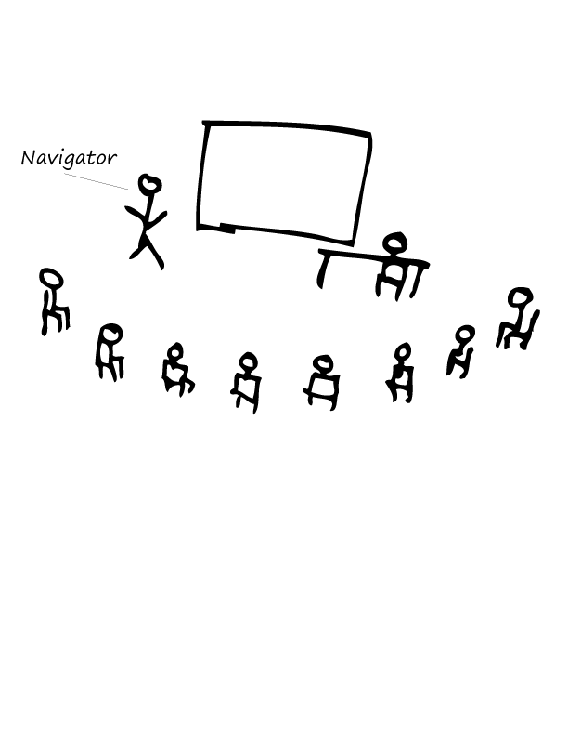
A day of mobbing

Slide 10
That would’ve been a nasty one to find later
* http://visible-quality.blogspot.fi/2015/09/my-first-full-day-of-mob-programming.html

Slide 11
Co-creation vs. Collaboration

Slide 12
Tales from Developer Tester Collaboration
Maaret Pyhäjärvi & Llewellyn Falco

Slide 13

1st session on unit testing
* http://visible-quality.blogspot.fi/2015/01/a-learning-journey-with-unit-tests-just.html

Slide 14

Strong Style Pairing
“For an idea to go from your head to the computer it must go though someone else’s hands”
*http://llewellynfalco.blogspot.fi/2014/06/llewellyns-strong-style-pairing.html

Slide 15


Farming vs. Hunting

Slide 16


“Look at me” Pairing

Slide 17
Why are we having issues?

Slide 18
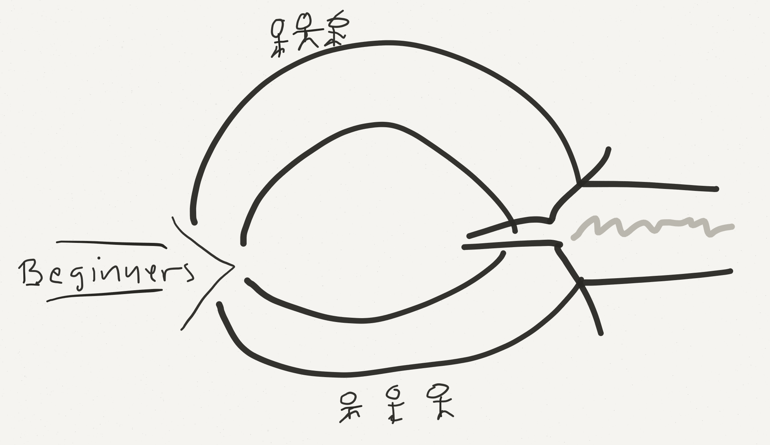
How we became how we are

Slide 19
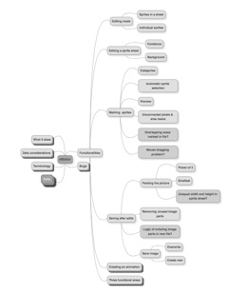
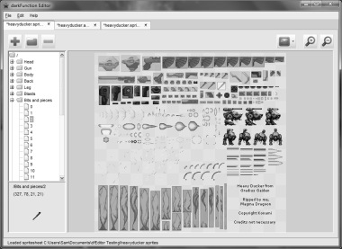
Exploratory Testing

Slide 20
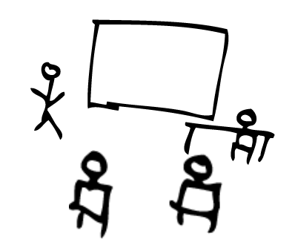

Testing Excel

Slide 21
What Testing Gives Us
Testing as performance
SPEC
FEEDBACK
REGRESSION
GRANULARITY
Unit Testing
GUIDANCE
UNDERSTANDING
SERENDIPITY
MODELS
Exploratory Testing
Testing as artifact creation
Notes:
This is what it is and what it could be. There’s a direction to it, not just statement of what it is.
Coaching is not just feedback, it’s pointing them to the right way.
EXPERIENCE (the verb) rather than facts ; emotions over facts. REACTIONS.
UNDERSTANDING – where you start (knowing the thing (code & environment), knowing the user, knowing the problems, knowing the developers (how to help them and what they do so that you can efficiently test), knowing the hackers (weird use cases outside common ‘have you tried reading it upside down’) , knowing all stakeholders, knowing the business priorities)

Slide 22
Why do this?
“It’s about getting the best (not the most)
out of everyone”

Slide 23
Quality

Slide 24
Quality

Slide 25
Learning's:
Some dev care about testing
Skilled tester exist
MindMaps are amazing
Remote desktop
Quality
Some testers are great product owners
Pairing & Mobbing
Testers don’t report everything
More powerful unit tests
Shortcuts & Cheats

Slide 26
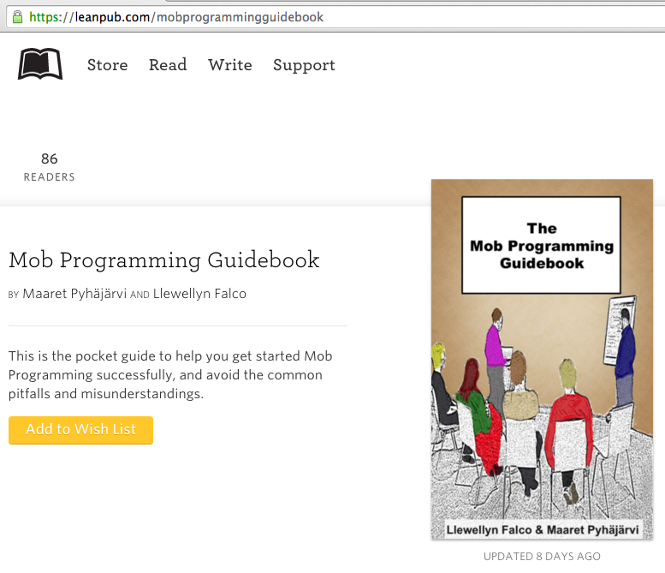
#MobProgrammingGuidebook

Slide 27
ROI of spending 1 hour a day
learning for a 1% increase
Output

Slide 28
ROI of spending 1 hour a day
learning for a 1% increase
5x (1 year)
Output
2x (6 months)
28 days

Slide 29

Thank you.
@maaretp
@LlewellynFalco
(please connect with us through Twitter or LinkedIn)

